Slide 1
ADC in STM32

Slide 2
ADC Features
12-bit ADC which is a successive approximation analog-to-digital converter
18 multiplexed channels allowing it to measure signals from sixteen external and two internal sources
Interrupt generation at the End of Conversion, End of Injected conversion, and Analog watchdog event
Single and continuous conversion modes
Scan mode for automatic conversion of channel 0 to channel ‘n’
Self-calibration
Data alignment with in-built data coherency
Channel-by-channel programmable sampling time
External trigger option for both regular and injected conversion
Discontinuous mode
Dual-mode (on devices with 2 ADCs or more)
ADC conversion time: 1 µs at 56 MHz (1.17 µs at 72 MHz)
ADC supply requirement: 2.4 V to 3.6 V
ADC input range: V_{REF}– ≤ V_{IN} ≤ V_{REF}+
DMA request generation during regular channel conversion

Slide 3

The STM32F070RB’s ADC is 12-bit, meaning it can represent an analog signal as one of 2^12 = 4096 levels.
So, 0V = 0, 1.65V = 2048, 3.3V = 4095.
The ADC takes time to convert an analog signal to digital, measured in clock cycles. For the STM32F070RB, a 12-bit conversion typically takes 12 ADC clock cycles plus a sampling time (e.g., 7.5 cycles), totaling ~19.5 cycles. At a 14 MHz ADC clock, this is ~1.4 µs per conversion.

Slide 4
How Does ADC Work Electronically?
Sample-and-Hold Circuit:
A capacitor holds the analog input voltage steady during conversion.
Controlled by the sampling time (e.g., ADC_SAMPLETIME_7CYCLES_5 in HAL), ensuring the input doesn’t change while the ADC “guesses” the value.
Comparator
Compares the held voltage with a test voltage generated by the DAC.
A differential amplifier outputs a high/low signal based on which voltage is greater.
Digital-to-Analog Converter (DAC):
Converts the SAR’s digital guess (e.g., 10000000) back to an analog voltage for comparison.

Slide 5
Control Logic and Clock
Manages the conversion process, timing each step with the ADC clock (e.g., 14 MHz on STM32F070RB).
A finite state machine (FSM) synchronized with the ADC clock (derived from PCLK or a dedicated clock source).

Slide 6
What is a Successive Approximation ADC (SAR ADC)?
SAR ADC turns an analog signal (like a voltage) into a digital number.
It’s like guessing a number using a yes/no game:
Example: Guess a number between 0-15. Is it 8? Too low! Try 12. Too high! Try 10. Correct! SAR ADC “guesses” the voltage step-by-step until it finds the right digital value. Visual: A balance scale with weights (analog input) and a digital number (output). Example: “Input: 1.65V → Output: 2048 (12-bit)”.
A Successive Approximation ADC (SAR ADC) converts an analog voltage into a digital value using a step-by-step binary search method.

Slide 7
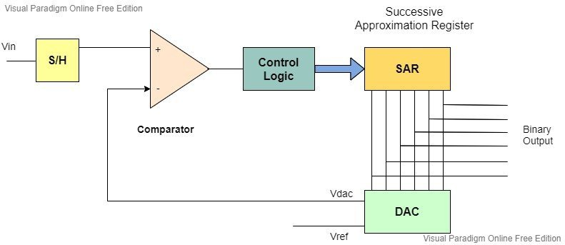

Slide 8
ADC Modes on STM
Single Conversion Mode: Converts one channel once and stops.
Ideal for one-time measurements (e.g., reading a button press voltage).
Example: Measure a single sensor value when triggered.
Continuous Conversion Mode: Repeatedly converts a single channel after starting.
Useful for monitoring a continuously changing signal (e.g., a potentiometer).
Example: Continuously read a temperature sensor.
Scan Mode:
Converts a group of channels sequentially in one go.
Useful when you need to read multiple sensors (e.g., multiple analog inputs).
Example: Read three sensors connected to ADC channels 0, 1, and 2.

Slide 9
Discontinuous Mode:
Converts a subset of channels in a group, triggered each time.
Reduces power consumption when you don’t need all channels at once.
Example: Read two channels per trigger, then wait for the next trigger.
Injected Conversion Mode:
Allows high-priority conversions triggered by specific events (e.g., timers).
Useful for time-critical applications.
Example: Capture an analog signal synchronized with a PWM signal.
DMA Mode:
Transfers ADC results to memory without CPU intervention.
Ideal for high-speed or multi-channel conversions.
Example: Store multiple ADC readings in an array for later processing.

Slide 10
Single-Channel Single-Conversion Mode

Slide 11
ADC setup using HAL
MX_ADC_Init(); // initialises the ADC with preconfigured settings
Clock settings, channel selection
HAL_ADC_Init(&hadc)
HAL_ADC_ConfigChannel(&hadc, &sConfig)
HAL_ADC_Start(&hadc1); //
HAL_ADC_PollForConversion(&hadc, HAL_MAX_DELAY);
Waits for the ADC conversion to complete by polling the EOC flag.
In multi-channel mode, called for each channel to advance to the next conversion in the sequence.
HAL_ADC_Start_IT(&hadc1);
Triggers the conversion and enables interrupts for EOC (single-channel) or EOS (multi-channel).
Sets ADC_IER, bit EOCIE (bit 2) for single-channel (EOC interrupt).
Sets ADC_IER, bit EOSIE (bit 3) for multi-channel with EOCSelection = ADC_EOC_SEQ_CONV (EOS interrupt).
Enables the NVIC interrupt for ADC1 (ADC1_COMP_IRQn)

Slide 12
HAL_ADC_GetValue(&hadc1);
Reads the converted value from the ADC data register.
Reads ADC_DR (Data Register), which contains the 12-bit result (bits 11:0 for right-aligned data).
Returns the value as a uint32_t (e.g., 0-4095 for 12-bit).
In multi-channel mode, ADC_DR contains the result of the current channel; HAL manages the sequence to ensure correct ordering.
HAL_ADC_Stop(&hadc1);
Halts the ADC after the conversion/sequence is complete, preparing it for the next trigger.
Sets ADC_CR, bit ADSTP (bit 4) to 1 to stop conversion.
Waits for the ADC to stop (checks ADSTART bit clears).
In interrupt mode, HAL_ADC_Stop isn’t explicitly called in the main loop because the ADC stops automatically after the sequence (since ContinuousConvMode = DISABLE).

Slide 13
What is ADC Calibration?
Due to imperfections in the manufacturing process or environmental factors (like temperature or supply voltage changes), the ADC may introduce errors in its output. One common error is the offset error, where the ADC's output is slightly shifted up or down from the true value.
ADC calibration is a process where the ADC measures and corrects for these errors (mainly offset errors) to ensure its output is as accurate as possible. During calibration, the ADC calculates a calibration factor, which is a correction value that the ADC applies internally to its measurements. This factor compensates for the offset error and is stored and used until the ADC is powered off.

Slide 14
Calibration Process: During calibration, the ADC performs internal measurements to determine the offset error. It does this by connecting its input to a known reference (often 0V or a specific internal reference voltage) and checking the output.
The ADC calculates a calibration factor, which is a value that, when applied to the ADC's output, cancels out the offset error.
The ADCAL bit remains set (1) during the entire calibration process to indicate that calibration is ongoing.
Completion of Calibration: Once calibration is complete, the hardware automatically clears the ADCAL bit (sets it to 0) to signal that the process is done.
The calculated calibration factor is stored in the ADC’s data register (ADC_DR), specifically in bits 6 to 0. You can read this value if needed, but typically, the ADC applies it internally.

Slide 15
ADEN (ADC Enable):
This is a control bit in the ADC_CR (Control Register).
Setting ADEN = 1 turns the ADC on (enables it).
When the ADC is fully powered up and ready, the ADRDY flag is set to indicate it’s good to go.
At power-up, ADEN = 0, meaning the ADC is disabled and in power-down mode (using minimal power).
ADDIS (ADC Disable):
This is another control bit in the ADC_CR register.
Setting ADDIS = 1 tells the ADC to turn off (disable) and enter power-down mode.
Once the ADC is fully disabled, the hardware automatically clears both ADEN and ADDIS to 0, confirming the ADC is off.
ADRDY (ADC Ready):
This is a status flag in the ADC_ISR (Interrupt and Status Register).
ADRDY = 1 means the ADC is fully powered up, stabilized, and ready to perform conversions.
ADRDY = 0 means the ADC is not ready (either it’s off or still stabilizing).
You can clear ADRDY by writing 1 to it (this is a common way in microcontrollers to clear status flags).
tSTAB (Stabilization Time):
After you set ADEN = 1 to enable the ADC, it needs a short time (called tSTAB) to stabilize its internal circuits before it can convert accurately.
Think of it like letting a car engine warm up for a few seconds before driving. If you start conversions before tSTAB is complete, the results may be inaccurate.
Power-Down Mode:
When the ADC is disabled (ADEN = 0), it’s in power-down mode, consuming very little power. This is useful for battery-powered devices to save energy when the ADC isn’t needed.

Slide 16
What is the ADC Clock?
ADC Asynchronous Clock
What is it?
This is a dedicated clock source (e.g., a 14 MHz clock) generated by the Reset and Clock Controller (RCC), separate from the APB clock (PCLK).
It’s called “asynchronous” because it doesn’t depend on or sync with the PCLK.
How to select it?
Set CKMODE[1:0] = 00 in the ADC_CFGR2 register.
APB Clock (PCLK) Divided
What is it?
The ADC uses the APB clock (PCLK), which is the clock for the peripheral bus, divided by a factor (1, 2, or 4) to create the ADC clock.
The division factor is set by CKMODE[1:0]:
CKMODE[1:0] = 01: PCLK divided by 2.
CKMODE[1:0] = 10: PCLK divided by 4.
CKMODE[1:0] = 11: Reserved (not used in your description).
How to select it?
Set CKMODE[1:0] to 01 (divide by 2) or 10 (divide by 4).

Slide 17
Channel selection (CHSEL, SCANDIR
The Analog-to-Digital Converter (ADC) in your microcontroller can
measure analog signals (like voltages) from multiple sources, called
channels. These channels are multiplexed, meaning the ADC can only
measure one channel at a time, but it can switch between them. You
can choose:
Which channels to measure (using CHSEL).
The order in which they are measured (using SCANDIR).

Slide 18
CHSEL (Channel Selection):
The CHSEL bits are in the ADC_CHSELR register (Channel Selection Register).
Each channel has a dedicated bit (CHSELx, where x is 0 to 17) to enable or disable it for conversion.
Setting CHSELx = 1 includes that channel in the conversion process; CHSELx = 0 excludes it.
Example: To measure ADC_IN3 and ADC_IN16 (temperature sensor), set CHSEL3 = 1 and CHSEL16 = 1.
SCANDIR (Scan Direction):
The SCANDIR bit is in the ADC_CFGR1 register (Configuration Register 1).
It controls the order in which the selected channels are converted:
SCANDIR = 0: Forward scan (Channel 0 to Channel 17).
SCANDIR = 1: Backward scan (Channel 17 to Channel 0).
This only matters if you’re converting multiple channels in a sequence (not just one channel).

Slide 19
Methods to achieve the Modes
Polling Based:
Interrupt Based:

Slide 20
MH-Sensor-Series (YL-28/FC-28) – Soil Moisture Sensor
How the MH-Sensor-Series Works
The MH-Sensor-Series operates on a simple yet effective principle based on the electrical properties of soil.
The sensor features two exposed metal probes (electrodes) that act as a variable resistor. These probes are inserted into the soil.
Water in the soil conducts electricity better than dry soil because it contains ions (e.g., from dissolved minerals). The more water present, the lower the resistance between the probes.
Dry soil has high resistance (poor conductivity), while wet soil has low resistance (good conductivity). The sensor measures this resistance and converts it into an output signal.

Slide 21
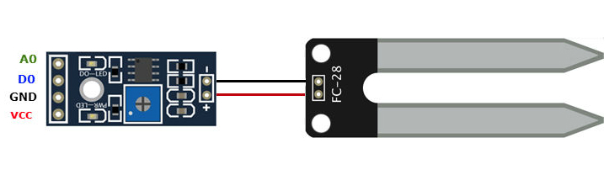
Sensor Diagram

Slide 22
Pin Usage
VCC (Power Supply)
Function: Supplies power to the sensor module.
Voltage: 3.3V to 5V. For the STM32F070RB, use 3.3V to match its logic levels, though 5V is common with Arduino setups.
GND (Ground):
AO (Analog Output):
Function: Outputs a voltage proportional to soil moisture (0V to VCC).
Use Case: Ideal for precise moisture percentage calculations, requiring calibration (e.g., mapping 4095 = dry, 0 = wet).
DO (Digital Output):
DO (Digital Output)
Function: Outputs a binary signal based on the potentiometer-set threshold.
Logic: High (e.g., 3.3V) when soil is drier than the threshold, Low (0V) when wetter.
Use Case: Useful for simple on/off applications (e.g., triggering a pump) without needing an ADC.

